Slide 1
Advanced MVVM Development in Windows 8
Gill Cleeren
@gillcleeren

Slide 2
Agenda
Thinking about Modern UI
MVVM Overview
Building Blocks
Data binding
Commanding
ViewModelLocator
Messaging
Application architecture
Navigation and window management
Data access and repositories
Data binding to Windows 8 controls
Working with contracts
Search
Working with tiles updates
Local
Push notifications
Lifecycle and state management
Unit testing the VMs and services

Slide 3
Thinking about Modern UI (aka the technology formerly known as Metro)
The artist previously known
as Prince

Slide 4
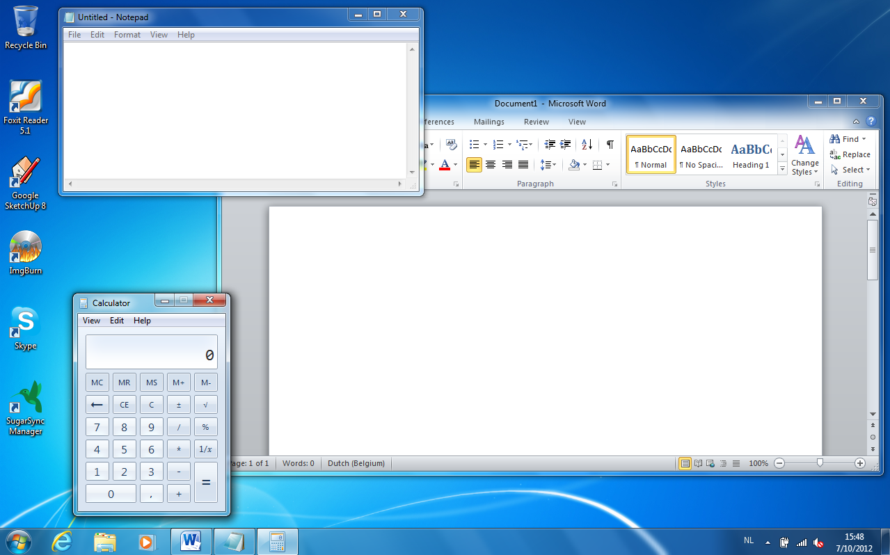
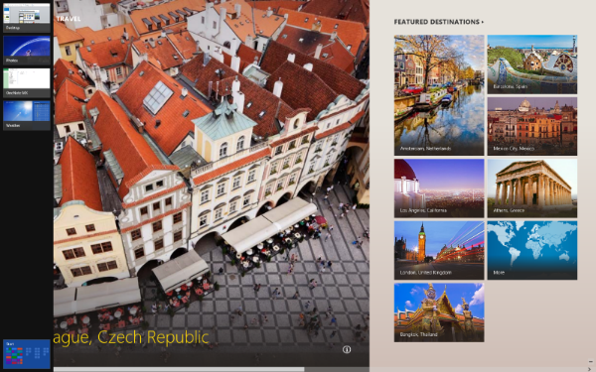
Modern UI is different
Content before chrome
Full screen apps
Snap view and filled view
Orientation and rotation
Windows are now “pages”
New ways of interacting with an app
App bar
Charms/Contracts
Lifecycle and tiles

Slide 5
MVVM and Modern UI
Currently most Modern UI apps are built in XAML
MVVM is supported in WPF, Silverlight, Windows Phone…
Core concepts of XAML are universal
Data binding, commands, DataContext, messaging
Each technology has some specifics
Navigation, controls, lifecycle management, background tasks…
Knowledge can be easily leveraged
Even to none-XAML based technologies (HTML5 with Knockout JS)

Slide 6
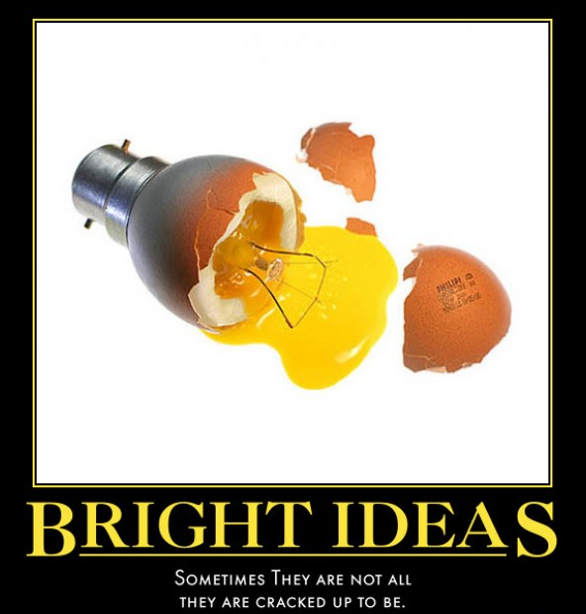
It’s a great idea…
to build Windows 8 apps using MVVM!
We’ll show you how!

Slide 7
MVVM Overview
For those who might not grasp every concept…

Slide 8
Hello MVVM
MVVM is an architectural pattern
Based on MVC pattern
In turn based on PresentationModel by Fowler
Introduced by John Gossman (WPF dude)
I <3 XAML

Slide 9
Hello MVVM
Leverages power of XAML framework
Data binding
Commanding

Slide 10
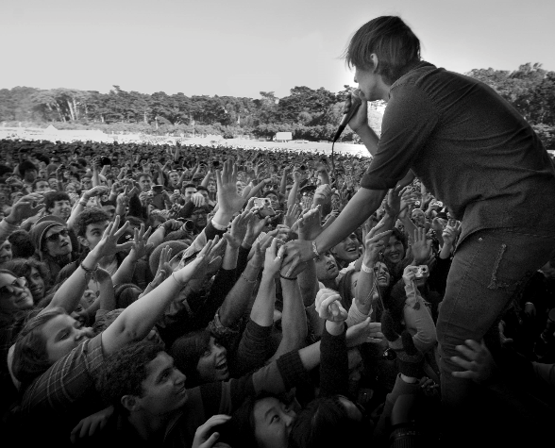
Hello MVVM
Became popular with Silverlight
Also applicable in
WPF
Windows Phone 7 and 8
Windows 8/WinRT

Slide 11
Here’s the design. Now let me go and play with my iPhone.
Woot, I can finally build my code without the designer messing things up!

Slide 12
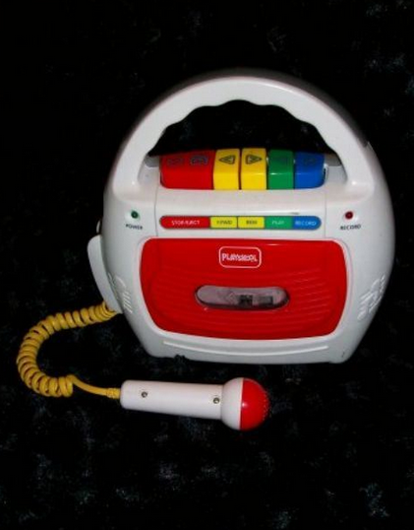
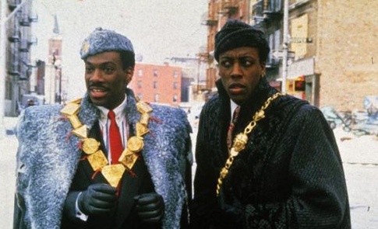
What we all did when we were young…
Watch Eddy Murphy arrive in America…
Tom Selleck’s moustache was closely monitored
Record ourselves…
Shoot ducks (and try shooting the damn dog)

Slide 13
What we all did when we were young…
And write code in code-behind… Lots of it.
View
XAML
Code-Behind
Event Handlers
Data Model

Slide 14
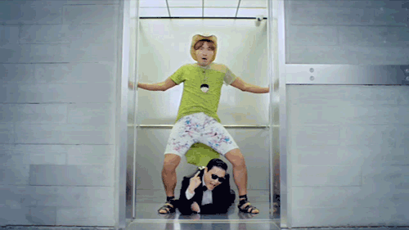
Meanwhile, in 2013, things have changed.
Not necessarily any better though…

Slide 15
Writing testable code however, is becoming the norm. Finally. Courtesy of MVVM.
View
XAML
Code-Behind
Data-binding and commands
Change notification
View Model
Data Model
State + Operations

Slide 16
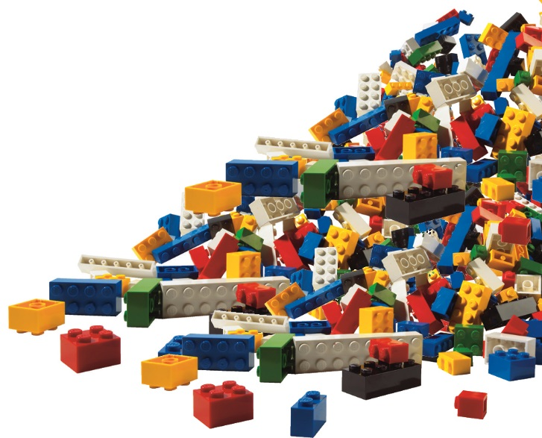
Building blocks of MVVM

Slide 17
Data binding
Data + binding
Data: properties of objects or collections thereof
Binding: linking these to properties of controls
Infrastructure for binding control properties to objects and collections
“Loosely coupled model
Bound control doesn’t need to know to what is being bound to
Exists in Silverlight, WPF, Windows Phone
The glue between view and viewmodel in MVVM

Slide 18
Data binding
What is supported in Windows 8?
Regular data binding
Element binding
Converters
Model binding using DataContext
Indexers
Data templating
Binding to a CollectionViewSource
Notifications
Single objects through INotifyPropertyChanged
Collections through INotifyCollectionChanged/ObservableCollection
DataTemplate and DataTemplateSelector
Exceptions in output window
<TextBlock Text="{Binding Name}" FontSize="32"></TextBlock>
<TextBlock Text="{Binding Address}" FontSize="32"></TextBlock>

Slide 19
That means...
Not all BindingBase properties are supported
No custom markup extensions
No implicit data templates
No data binding breakpoints
...
More or less at the level of Silverlight 3

Slide 20
Data templates
Block of XAML that is generated for each item of the source list
Mostly used on List controls such as the GridView or ListView
Uses regular data binding syntax
Source for binding is the individual item
Windows 8 doesn’t know
AncestorType/AncestorLevel for RelativeSource Binding
Implicit data templates

Slide 21
The View
Represents the user interface that the user will see.
Can be a user control or Data Template
Keep it simple
Clean code-behind
Only visual logic (all the rest should go in the ViewModel)
Should never contain anything that is to be tested
Model-related

Slide 22
The ViewModel
An abstraction of View, definition of what can be shown on screen
Glue between View and Model
Implements INotifyPropertyChanged
Contains
State properties: data
Operations: commands
Validation support
Should not contain “view properties” such as Color
Use converters for this
Often wraps or “re-models” the model for the View to use
Must be testable
No control references!
Often, 1 ViewModel per View
Can be 1-to-many or many-to-1
Manages the flow of the application
Interacts with the model

Slide 23
The Model
Data model, service reference/proxy classes, DTO…
Very often, an extra layer is added on top of the generated proxy classes
Validation logic
Data access
No reference to ViewModel

Slide 24
Who knows who?
Commands
Properties
Behaviors
View
ViewModel
Model
PropertyChanged

Slide 25
Linking the View and the ViewModel
Data binding is the glue but…
A view needs to “find” its ViewModel
ViewModel is the DataContext
2 options:
View-First: ViewModel gets created because View is created
DataTemplates
ViewModel-First: ViewModel is created and View gets selected
ViewModel locator: indirection layer

Slide 26
Locator pattern
Implemented through a class that contains all VMs as properties
An instance is then made available as Resource
All Views can bind, no code needed in View
Clean way
Not good since all VMs need to be known upfront
Property for each available VM
Not easy if more than one instance exists of a View
In this case, some form of IOC is recommended

Slide 27
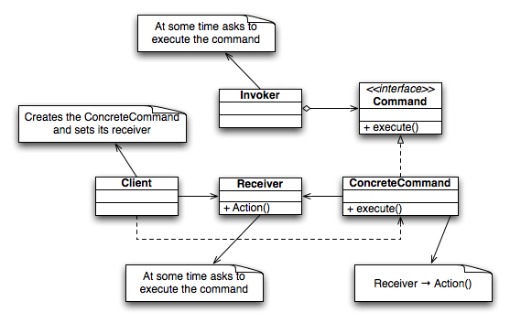
Commands
MVVM-based code have no event handlers in code-behind
How to handle events happening in the UI?
Commands
Based on Command pattern
In object-oriented programming, the command pattern is a behavioral
design pattern in which an object is used to represent and
encapsulate all the information needed to call a method at a later time.
his information includes the method name, the object that
owns the method and values for the method parameters.

Slide 28
Commands
WinRT has the ICommand interface
Execute()
CanExecute()
CanExecuteChanged event
public interface ICommand
{
event EventHandler CanExecuteChanged;
bool CanExecute(object parameter);
void Execute(object parameter);
}

Slide 29
Commands
Way to create commands:
Write ICommand implementation
Create instance on VM
Bind Command property of control to this instance
Works only on some controls
Rest needs to use behaviors

Slide 30
Behaviors
Block of code that we can attach to XAML element
Promotes reuse
Useful in MVVM scenarios on controls that don’t support commanding
Avoids having code in code-behind
Supported by Blend
Not supported by Windows 8 ☹
Neither are triggers
EventToCommand is therefore not available by default
The community has the answer!
Notes:
http://dotnetbyexample.blogspot.be/2012/03/attached-behaviors-for-windows-8-metro.html

Slide 31
Using EventToCommand as a behavior
Take a look at WinRtBehaviors on CodePlex/NuGet (Joost van Schaik)
Works through Attached behaviors
Attached dependency property
<TextBlock Text="TextBlock" FontSize="48">
<WinRtBehaviors:Interaction.Behaviors>
<Behaviors:EventToBoundCommandBehavior Event="Tapped"
Command="{Binding TestCommand}"
CommandParameter="{Binding TestProperty, Mode=TwoWay}"/>
</WinRtBehaviors:Interaction.Behaviors>
</TextBlock>
Notes:
http://dotnetbyexample.blogspot.be/2012/03/attached-behaviors-for-windows-8-metro.html
Defined through attached dependency properties
▪ Define a change callback handler for when the property gets set
▪ Use the reference to the element to which your behavior is attached
to add functionality to that element
▪ Set the property in a XAML page that uses that element
▪ Downside is that the entire behavior is defined in terms of static
properties and methods
□ Need to be careful with event subscriptions and maintaining state for
multiple elements that it might get attached to

Slide 32
Communication between VMs
View Model
View Model
View Model
View Model
View Model
View Model
View Model
View Model

Slide 33
Messaging
View
View
XAML
XAML
Code-Behind
Code-Behind
View Model
Data Model
View Model
Data Model
State + Operations
State + Operations
Message
Publish messages
View
XAML
Subscribe to messages
Code-Behind
Event Aggregator
View Model
Message
State + Operations

Slide 34
Communication between VMs
VM’s need to be able to talk to each other, eg: send messages to each other
Not a good idea to have each VM reference all other VMs
Solution:
Event Aggregator/mediator/messenger
VM can register to receive messages of a certain type (for example string messages)
Another VM can register with the same messenger to send messages
This allows both VMs to communicate with each other without tight coupling

Slide 35
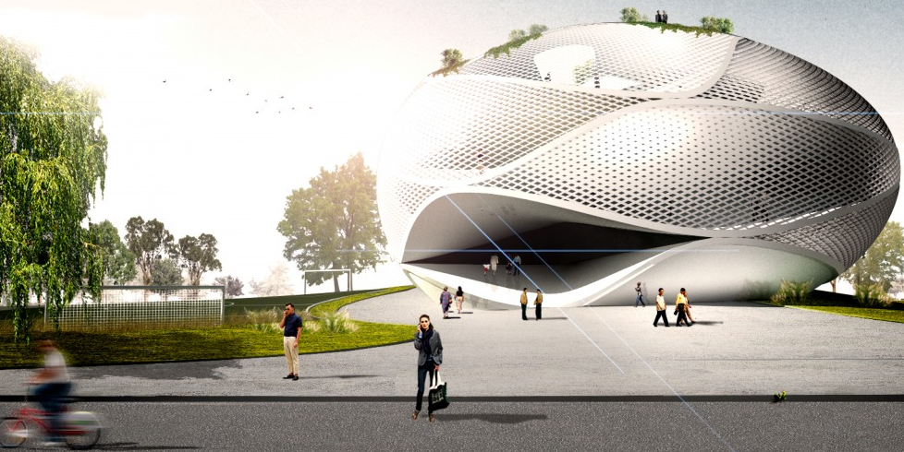
Application architecture

Slide 36
From the ground up!
Core principles for a testable and maintainable architecture
Separation of concerns
“A new class doesn’t cost a thing”
Repositories
Loose coupling
Dependency injection
Unit testing and mocking

Slide 37
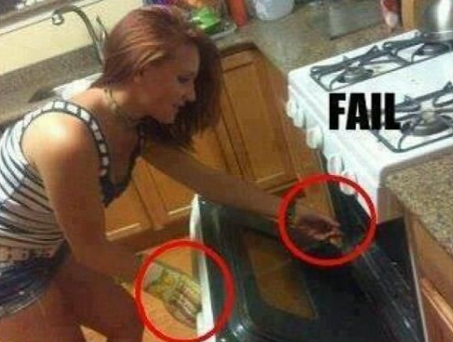
Contoso Cookbook: freshly baked using MVVM
DEMO

Slide 38
The container

Slide 39
The container
Loose coupling is achieved through dependency injection
Dependencies are instantiated and maintained through container
MVVM Light comes with SimpleIOC
Not very extended when it comes to managing lifetime of objects
NuGet offers alternatives
MetroIOC
TinyIOC
AutoFac
Can be used to manage
ViewModels
Views
Services
…

Slide 40
Abstraction for the container
Avoid making direct calls to your container from code
Instead, introduce an abstraction layer for your container
Code not dependent on container
If container changes, only one class needs changing

Slide 41
The container: MetroIOC

Slide 42
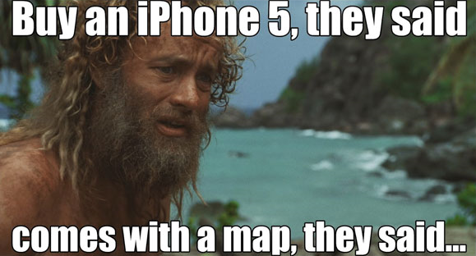
Navigation and window management

Slide 43
Pages and Frames
Windows 8 apps know pages: this is the “window”, top-level control
Used as Views in MVVM scenario
No visible chrome
Frame will host pages
One page at a time
Performs navigation from page to page
Frame.Navigate()
Frame.GoBack()
Single Frame is created at application level
First view gets loaded after splash screen
Extended splash screen is MVVM view as well

Slide 44
Navigation and SOC
Navigation is not the task of the ViewModel
Navigation is not the task of the View
… and most certainly not the task of the Model
Then, whose task is it?
Separate service that has link to Frame
Called from ViewModels
Static
Dynamic
NavigationService is injected in ViewModels through IOC
Easily mockable
No hard dependency on specific implementation in ViewModels
Often, single instance is created application-wide and passed through injection/container

Slide 45
Window management
Windows 8 apps don’t use MDI interfaces, have separate windows though
Exception dialog
Confirmation window
Message dialog
Managed through separate service
Called from ViewModels
Again good news for testing and SOC

Slide 46
Navigation and window management
DEMO

Slide 47
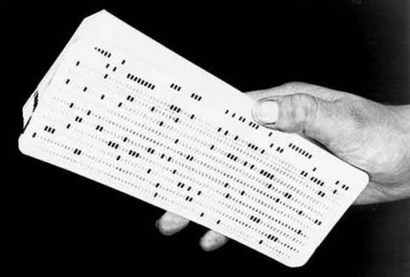
Data access and repositories

Slide 48
Repositories
Abstraction between data persistence and data consumption code
Allows changing implementation of persistence code without changing consumer
Easier to test
Creates central location for all data access
Advantage in the case where data will be cached locally
A repository often manages access to single resource collection
More than one entity type on single repository though
Parent-child relation

Slide 49
Data services
Since repositories often work with a single entity, they are not a good hook for the ViewModels
Would make the ViewModel responsible for combining response of several repository reponses
Create separate service for data acess
Per “unit of functionality”
Shared between ViewModels
Often created application-wide through IOC container
Injected into ViewModels through DI

Slide 50
Data access and repositories
DEMO

Slide 51
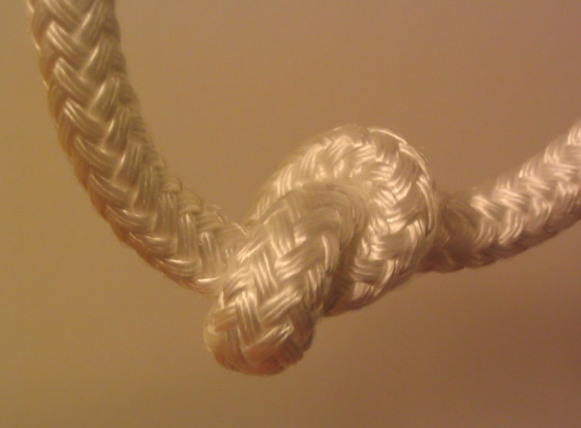
Data binding to Windows 8 controls

Slide 52
Windows 8 and lists of data
Data lists are everywhere
RSS feeds
Flickr images
News updates
Local file system enumerations
…
Microsoft has focused on creating controls that work with these lists
GridView
ListView
FlipView
Semantic Zoom
Support data binding
Some require a little bit of help though!

Slide 53
GridView in MVVM

Slide 54
Semantic zoom done right
Touch-based technique for presenting and navigating large sets of data in a single view
Based on 2 modes
Low level: zoomed-in mode
Shows all data in a flat structure
High level: zoomed-out mode
Shows items in groups
Typical uses:
Addressbook
Photo album
Product catalog

Slide 55
Using the semantic zoom control
Contents can be anything that implements ISemanticZoom
ListView
GridView
Most of the time, you’ll use 2 GridViews
<SemanticZoom>
<SemanticZoom.ZoomedOutView>
<!-- Put the GridView for the zoomed out view here. -->
</SemanticZoom.ZoomedOutView>
<SemanticZoom.ZoomedInView>
<!-- Put the GridView for the zoomed in view here. -->
</SemanticZoom.ZoomedInView>
</SemanticZoom>

Slide 56
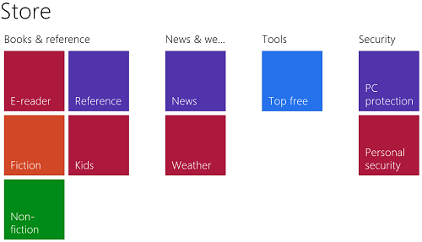
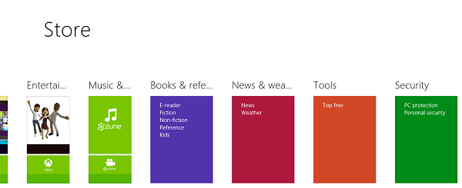
A typical semantic zoom

Slide 57
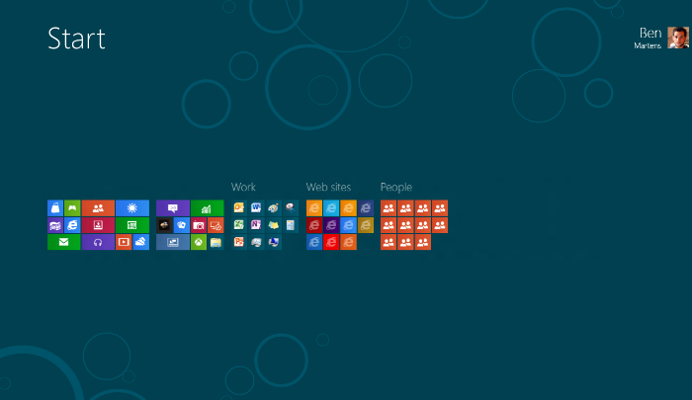
Semantic zoom in MVVM
DEMO

Slide 58
Working with contracts

Slide 59
Sharing in Windows 8
Sharing used to go via clipboard or locally saving content
Sharing is in fact from one app to another
Often time-consuming, sometimes confusing
Windows 8 has the Share charm
Share contract works when tapping the Share charm
Offers “lightweight, in context” sharing capabilities
Sharing happens between 2 apps
Source app: app that wants to share data
Target app: app that can accept data as destination
An app can be both a source and a target
Can share with itself

Slide 60
Sharing in Windows 8
Share pane (Win + H)
List of apps that can accept the data
Depends on the data being shared
Quicklinks
Selected app normally opens a specific share view
Optimized to just handle the share operation
Closes after finishing the “sharing task”
Sharing apps don’t have to know each other
Works through broker
Pub/sub model

Slide 61
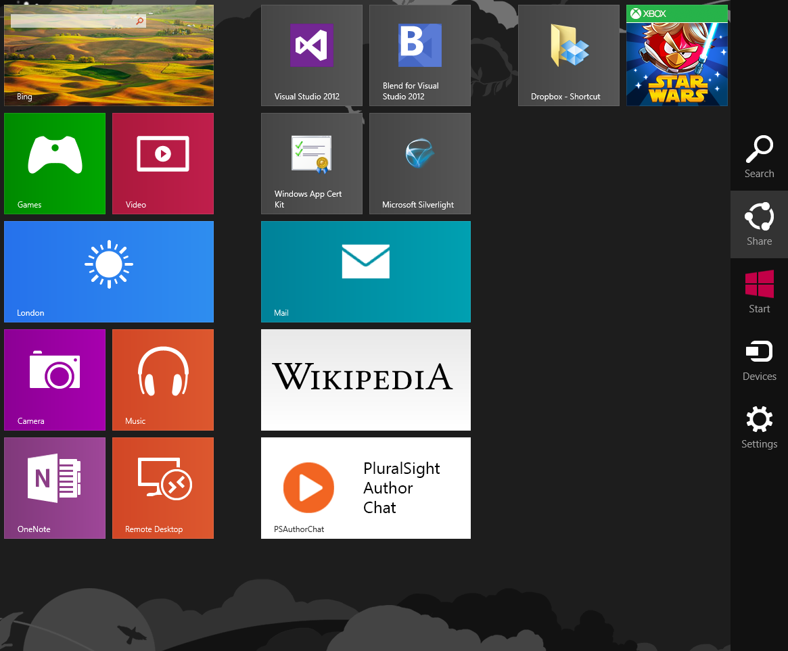
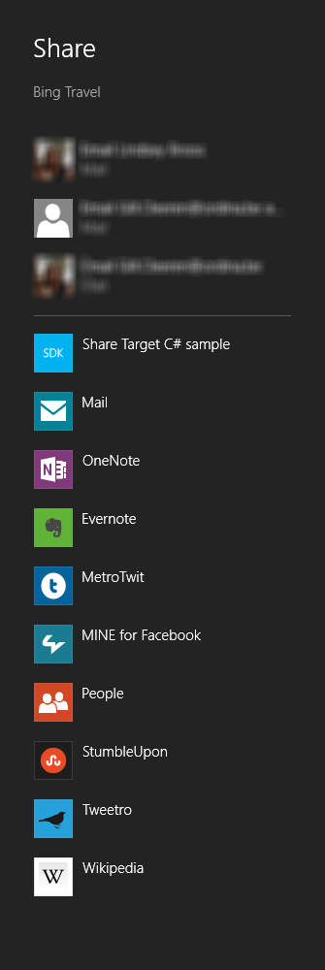
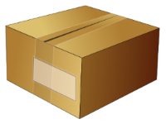
Sharing between 2 apps
Register with
DataTransferManager
DataRequested event
Source app
Create data
to share
DataRequested
All done!
Activated
for share
target
Target app

Slide 62
Sharing using MVVM
Share source
Separate service will register with the DataTransferManager
Will also get in data to share when requested
ViewModel control this service but don’t directly interact with the DataTransferManager
Share target
Separate View for the Share operation
Separate ViewModel for the Share view
Service can be used to complete the share operation

Slide 63
Working with contracts
DEMO

Slide 64
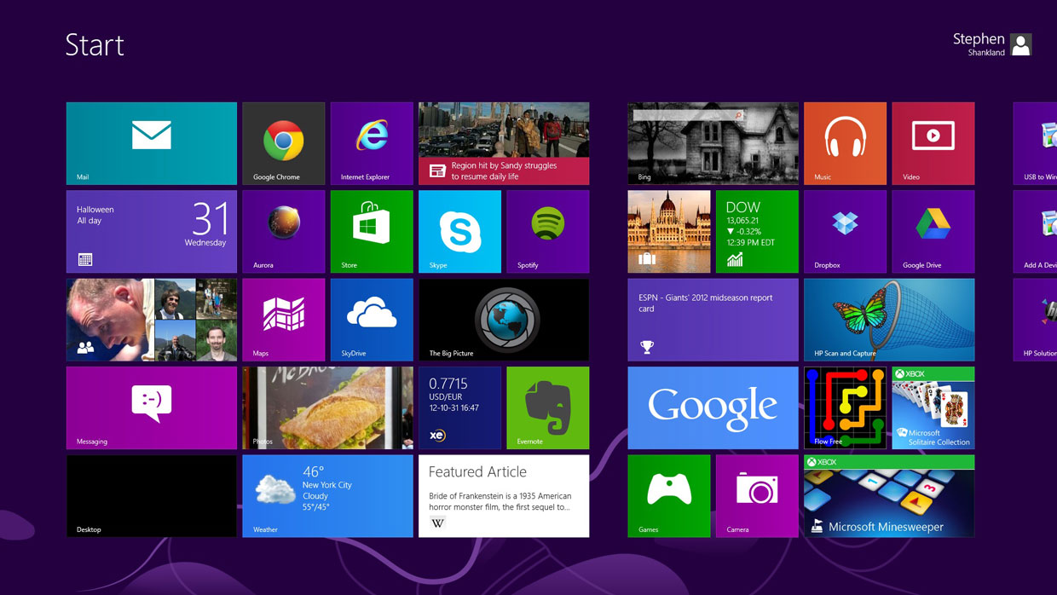
Working with tiles

Slide 65
Tiles
Tiles can be updated in several ways
Local (from the app code)
Can only be used when the app is running
Useful for tile updates (not that useful for toasts)
Scheduled
Update at specific time
Useful for tiles and toasts
Periodic
Update at specific interval
Poll a cloud service for content
Push notifications
Updates are sent from the cloud
Ideal for updating the tile without the app being executed

Slide 66
Local updates using MVVM
Again not the role of the ViewModel to update a tile/badge/toast
Separate service is required
Can work with data access service to get information
Can work with navigation service to navigate to correct page and pass contextual information
Can be mocked out to be able to test in isolation

Slide 67
Working with tiles DEMO
DEMO

Slide 68
Push notifications
Backend
event
Service
DB
ChannelUri
App
ChannelUri
Client Notification
Platform
WNS

Slide 69
Working with Push Notifications
DEMO

Slide 70
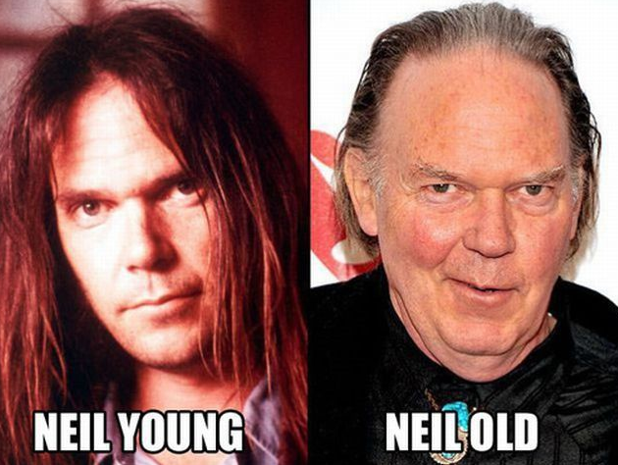
Lifecycle and state management

Slide 71
Process lifecycle in Windows 8
Launching
Running
Suspending
Not running
Not running/
Terminated
Suspended
Resuming
Termination
App Close
App crash

Slide 72
Process lifecycle management
Managing state information is required
Suspended apps may not return and get terminated
Users expect to see the app in the same state they left it
Syncing state between multiple devices may be expected
The app could be updated to a newer version
While suspended, the app may be activated, triggering a different page
...
Can be done using
Application Data API
LocalSettings/LocalFolder
RoamingSettings/RoamingFolder
Via specific service then to repository
It’s not the task of the ViewModel to manage this
A service has this responsibility

Slide 73
What should be saved?
App data
Persistent across application reboots
Should be saved incrementally
Session data
More temporary of nature
Saved mostly for suspending/termination
Includes often location within a multi-page app

Slide 74
Lifecycle and state management
DEMO

Slide 75
Unit testing the VMs and services
Notes:
http://channel9.msdn.com/Events/TechEd/Europe/2012/WPH208

Slide 76
Unit testing in MVVM
Using MVVM goes hand-in-hand with unit testing
SOC: Because we use services for all external tasks, the VMs can be tested in isolation
DI: possible to pass mock services so that our test is not depending on external influences
Difficult to test code that interacts directly with UI
Mocking is recommended
Unit test not depending on external components
Supply a stub/fake
DI/abstraction layer is required

Slide 77
Unit testing the VMs and services DEMO
Notes:
http://channel9.msdn.com/Events/TechEd/Europe/2012/WPH208

Slide 78
Summary
It’s a great choice to build using MVVM
Services, services and yes services
Build your next big thing, but now better!

Slide 79
Q&A

Slide 80
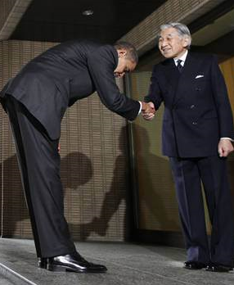
Thanks!

Slide 81
Advanced MVVM Development in Windows 8
Gill Cleeren
@gillcleeren

